Slide 1


Beamspace Channel Estimation for Wideband Millimeter-Wave MIMO with Lens Antenna Array
Xinyu Gao¹, Linglong Dai¹, Shidong Zhou¹, Akbar Sayeed², and Lajos Hanzo³
¹Department of Electronic Engineering, Tsinghua University
²Electrical and Computer Engineering, University of Wisconsin-Madison
³Electronics and Computer Science, University of Southampton
2018-5-21
Notes:
Good morning everyone. My name is Xinyu Gao from Tsinghua University. The title of my presentation is Beamspace Channel Estimation for Wideband Millimeter-Wave MIMO with Lens Antenna Array. The recently proposed mmWave MIMO with lens antenna array is a promising low RF complexity technique. The beamspace channel estimation is indispensable for this technique to achieve its benefits. However, most of the existing methods have only been designed for narrowband systems, while mmWave MIMO are more likely to be wideband. In this talk, we will investigate the wideband beamspace channel estimation.

Slide 2
Contents
1
Technical background
2
Proposed solution
3
Simulation results
4
Conclusions
Notes:
This talk consists of 4 parts. At first, we will introduce the technical background.

Slide 3
Wideband mmWave MIMO
Advantages
  High frequency (30-300 GHz): wider bandwidth (20 MHz → 5 GHz)
  Short wavelength: larger antenna array (1~8 → 256~1024)
  High directive transmission: more suitable for small cells
mmWave MIMO
High frequency
Short wavelength
Directive transmission
Wide bandwidth
Large antenna array
Small cell
1000x data rates increase!
Notes:
As we can see from the figure, mmWave MIMO enjoys several advantages. First, the spectrum at mmWave is less crowed and therefore we can provide much wider bandwidth. Second, the large antenna array is easy to arrange in a compact form at mmWave frequencies to achieve high antenna gains. Finally, mmWave MIMO is also appropriate for small-cell as the high directive transmission can avoid multi-cell interferences. As a result, mmWave MIMO will be a promising technique to achieve significant increase in data rates.

Slide 4
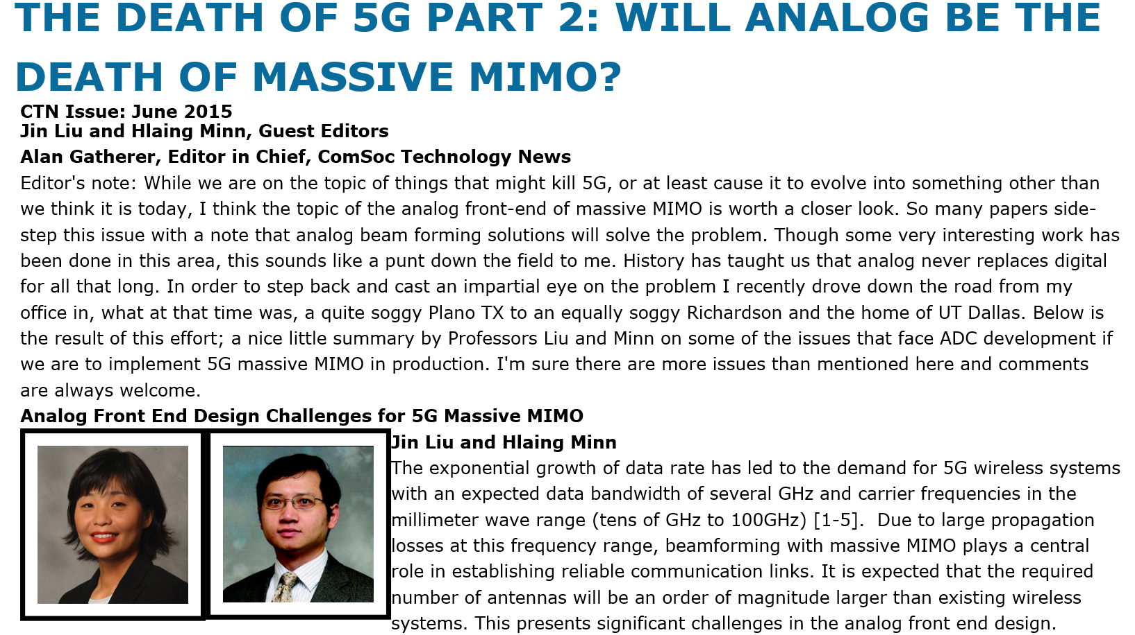
Bottleneck
Challenges
  Traditional fully digital MIMO: one RF chain for one antenna
  Large antenna array → Enormous number of RF chains
  RF chain is energy-intensive at mmWave (300 mW/RF chain)
  High energy consumption is the bottleneck problem
  256 antennas at BS → 76.8 W (only RF chains)
  Micro-cell BS in 4G (baseband + RF + transmit): → less than 10 W
How to reduce the number of RF chains?
Notes:
However, realizing mmWave MIMO is not a trivial task. One challenge is that each antenna in the conventional MIMO systems requires one dedicated RF chain. This will result in unaffordable hardware cost and energy consumption in mmWave MIMO, since the number of antennas becomes huge and the energy consumption of RF chain is high. (For example, at 60 GHz, one RF chain will consume 300 mW. If we consider a mmWave MIMO base station with 256 antennas, only the RF chains will consume 76.8 Watts. It is much higher than the that of current 4G micro-cell BS). Therefore, how to reduce the number of RF chains will be an urging problem to solve.

Slide 5
Lens-based wideband mmWave MIMO
Basic idea
  Focus power of signals from different directions by lens antenna array
  Sparse beamspace channel due to limited scattering
  Select power-focused antennas
  Reduce the MIMO dimension as well as the number of RF chains
Notes:
To this end, wideband mmWave MIMO with lens antenna array has been recently proposed. By employing lens antenna array, it can focus the mmWave signals from different paths on different antennas, and thus transform the spatial MIMO channel to the sparse beamspace MIMO channel. This enables us to preserve only a small number of power-focused antennas via the adaptive selecting network. Consequently, the number of RF chains can be reduced, and the bottleneck of high energy consumption can be relieved.

Slide 6
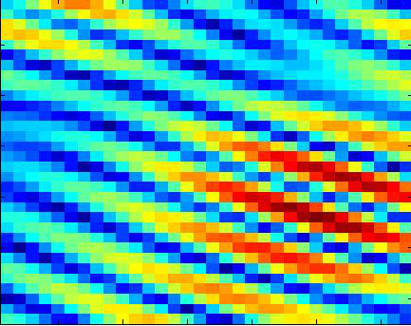
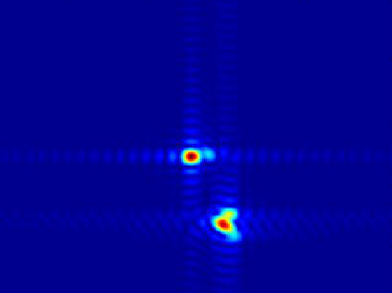
Beamspace channel
Spatial channel
Beamspace channel
Sparse!
Lens array
Notes:
In this slide, we show some figures to further explain the effect of lens antenna array. This figure shows the prototype of lens antenna array. This figure shows the power focusing capability of lens. This figure shows the power distribution of the conventional spatial MIMO channel, while the last figure shows the beamspace MIMO channel. Obviously, we can see that the beamspace channel is sparse.

Slide 7
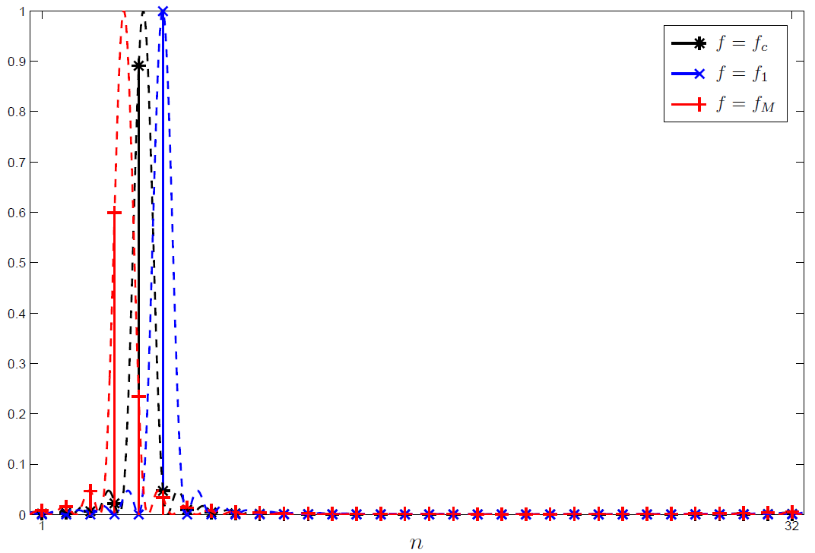
Wideband beamspace channel estimation
Existing wideband schemes
  OMP-based scheme, SOMP-based scheme, and so on
  Assume the channel share a common support over whole bandwidth
Beam squint
  Spatial direction: , where
  Wideband systems: , is frequency-dependent
  Power-focused antennas vary over frequency
Common support is not really valid in practice !
Notes:
Since the beamspace channel is sparse, we can estimate it via the compressive sensing algorithms. The existing solutions include the OMP, SOMP, and so on. However, all these algorithms assume that the beamspace channel share a common support over the whole bandwidth. This assumption, unfortunately, is not really valid due to the effect of beam squint. The beam squint means that in wideband systems with large antenna arrays, the spatial direction of the signal conveyed by each path should be frequency-dependent. As a result, the indices of power-focused antennas will vary over frequency as we can see from this figure, and the support of beamspace channel should be different at different frequencies.

Slide 8
Contents
1
Technical background
2
Proposed solution
3
Simulation results
4
Conclusions
Notes:
To tackle this problem, we propose a successive support detection (SSD) algorithm without the common support assumption.

Slide 9
Wideband beamspace channel
Wideband spatial channel at sub-carrier m
  : frequency at sub-carrier m,
  : spatial direction at sub-carrier m,
  : steering vector of .
Wideband beamspace channel
  : DFT matrix realized by lens antenna array
  : the l-th sparse path component at sub-carrier m
small
sparse !
Notes:
Firstly, we will describe the wideband beamspace channel mathematically. The wideband spatial channel at sub-carrier m can be presented by this equation, here N and L are the number of antennas and paths, respectively, beta and phi are the path gain and spatial direction of a path, respectively, and a is the steering vector related to the spatial direction.
The wideband beamspace channel can then be presented by this equation. Here U_a is the spatial DFT matrix realized by the lens antenna array, c_wave denotes one path component of the beamspace channel, which is defined like this. Note that c_wave is a sparse vector as shown in this figure and L is a small number due to the limited scattering. Therefore, the beamspace channel should be sparse.

Slide 10
Problem formulation
Pilot transmission
  TDD model
  Users transmit mutually orthogonal pilot sequences
  Channel estimation for each user is independent
Wideband beamspace channel estimation for one user
  Baseband system model (after OFDM modulation/demodulation)
  After Q instants of pilot transmission
  is realized by adaptive selecting network (1-bit phase shifters)
  All elements of belong to
Classical MMV problem in compressive sensing!
Notes:
Next, we formulate the problem. We consider the channel estimation in TDD model. All users transmit orthogonal pilots to the base station, and therefore the channel estimation for each user is independent. Consider one user, after Q instants of pilot transmission, the received pilots in the baseband can be presented by this equation. Here, W_hat is the receiver combining matrix realized by the adaptive selecting network, and its element can be randomly selected from normalized 1 and -1. Now, we can see that the wideband beamspace channel estimation is equivalent to the classical MMV problem in compressive sensing. However, since the common support assumption is no longer valid, we need to design a new algorithm to solve this problem.

Slide 11
Overview
Our solution
  Each path component enjoys frequency-dependent spare structure
  Estimate all path components one-by-one
  Utilize the sparse structure to improve the estimation accuracy
Notes:
The key idea of the proposed algorithm can be summarized in this figure. We first prove that each path component of the wideband beamspace channel exhibits a frequency-dependent sparse structure. Based on this, we then propose to estimate all sparse path components one by one like the classical SIC detector. For each path component, its supports at different frequencies are jointly estimated to improve the accuracy, and
then its influence is removed for the following estimation.

Slide 12
Sparse structure (1)
Lemma 1. Consider the l-th path component of the wideband beamspace channel and define as the spatial direction of the l-th path component at carrier frequency. Then, the support of is only determined by as
where is the mod function, determines how much power to preserve by assuming as a sparse vector with support , and we have
Insights
  Estimating for is equivalent to estimating
How to estimate ?
Notes:
Next, we will explain the aforementioned frequency-dependent sparse structure. Lemma 1 demonstrates that the support of each path component c_wave at different subcarriers can be uniquely determined by its spatial direction phi_c at the central-carrier frequency, which is defined by this equation. This lemma indicates that estimating the path support at different subcarriers is equivalent to estimating phi_c, which imposes another question: how to estimate phi_c for each path component?

Slide 13
Sparse structure (2)
Lemma 2. Define when . Then, the power of the s-th column of can be presented as
where . Moreover, we define a beamspace window (BWin) centered around n as . The ratio between the power of the sub-matrix
And the power of can be presented as
Insights
  If , most of the power of can be captured by
  If , using leads to serious power leakage
Notes:
To answer this question, we give Lemma 2 in this slide. We first collect one path component at all subcarriers into a matrix form C_n, and assume that its phi_c equals a spatial direction phi_n predefined by the lens antenna array. Then, the power of the s-th column of C_n can be presented by this equation. Furthermore, if we define a beamspace window rn centered around n like this. Then, the power of the sub-matrix with column indices in rn can be presented by this equation. This lemma implies that if phi_c is equal to the assumed value phi_n, using the beamspace window rn, most of the power can be captured. Otherwise, there will be a serious power leakage.

Slide 14
An example
By carefully designing BWins, we can efficiently estimate
Notes:
An example is shown in this figure. We can see that when phi_c equals phi_3, using r3 can capture most power of C3. However, when phi_c equals phi_5, still using r3 will lead to serious power leakage. This indicates that by carefully design the beamspace windows, we can efficiently estimate phi_c.

Slide 15
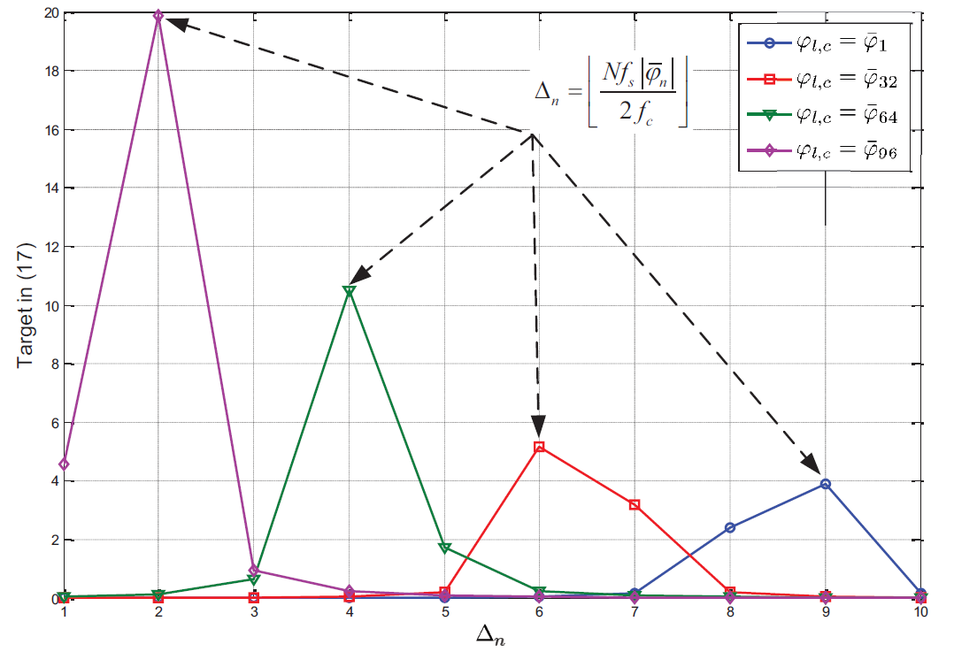
Design the beamspace window
How to select
  If is too large or too small → multiple BWs capture the similar power
  : make the power leakage incurred by as much as possible
Notes:
The remained problem is how to design the beamspace window range delta_n. In general, when delta_n is too large or too small, there may be several beamspace windows that capture the similar power of Cn. This makes the estimation of phi_c sensitive to noise or interference in practice. Therefore, delta_n should be carefully designed to ensure that the power leakage incurred by phi_c unequal phi_n as high as possible. Mathematically, this problem can be formulated by this equation. With some derivations, the optimal delta_n can be calculated as this. The figure in this slide shows that the derived optimal Δn satisfies our requirement and can be expected to achieve a good performance.

Slide 16
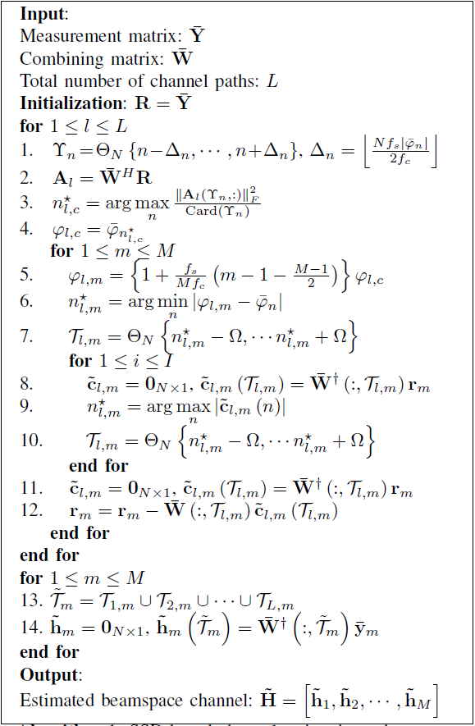
Successive support detection (SSD) algorithm
Estimate with different BWins
Estimate based on
Further refine
Remove the influence of
The overall channel estimation
Notes:
Based on the discussions so far, we propose a successive support detection algorithm, where the pseudo-code is provided in the table. During the l-th iteration, in steps 1 to 4, we generate N beamspace windows to estimate phi_c of the l-th path component. Then, in steps 5-7, we utilize phi_c to jointly estimate the support of the l-th path component at different subcarriers. After that, in steps 8-10, we use the estimated support as an initial solution and further refine it by estimating the index of the strongest element. Finally, in steps 11 and 12, we remove the influence of the l-th path component for the following estimation. After the supports of all path components have been detected, we can obtain the total support of beamspace channel in step 13, and estimate the nonzero elements via the LS algorithm in step 14.

Slide 17
Contents
1
Technical background
2
Proposed solution
3
Simulation results
4
Conclusions
Notes:
Next, we will provide simulation results to verify the advantages of our method.

Slide 18
Simulation parameters
System parameters
  MIMO configuration:
  OFDM setup:
  Number of instants for pilot transmission:
Channel parameters for each user
  Channel model: Saleh-Valenzuela model
  Antenna array: ULA with antenna spacing
  Number of resolvable paths:
  Path delay: and
  Path gain:
  Physical direction:
Algorithm parameter
  Sparsity range: ; Iterations of support refinement:
Notes:
The detailed simulation parameters are listed in this slide. We consider a wideband mmWave MIMO-OFDM system, where the BS equips a 256-element lens antenna array and 8 RF chains to serve 8 single-antenna users. The central-carrier frequency is 28GHz, the number of sub-carriers 128, and the bandwidth is 4GHz. The multi-path channel model is adopted, where we assume that the number of paths is 3.

Slide 19
NMSE performance against SNR
Observations
  pilot instants per user
  OMP: inaccurate at the low SNR region
  SOMP: inaccurate at the high SNR region
  SSD: higher accuracy in all SNR regions & close to the Oracle LS
Notes:
This slide shows the NMSE performance against SNR, where the red line and blue line present the SOMP algorithm and OMP algorithm, respectively. The green line presents the proposed SSD algorithm, while the black line denotes the oracle LS algorithm where the channel support is perfectly known. We observe from this figure that the OMP algorithm is inaccurate when the SNR is low, since it cannot use the sparse structure of beamspace channel to suppress the noise. The SOMP algorithm is inaccurate when the SNR is high, since common support assumption is not really valid. By contrast, the proposed algorithm enjoys much higher accuracy than existing schemes in all considered SNR regions and achieve the NMSE close to the oracle LS.

Slide 20
Sum-rate performance against SNR
Observations
  Wideband beam selection is used to transmit data
  Beam selection along with our scheme can achieve higher sum-rate
  Moderate channel accuracy is enough
Notes:
This slide shows the achievable sum-rate of the wideband beam selection along with different beamspace channel estimation algorithms. Again, the red line presents the our method. We observe from this figure that by utilizing our method, the system achieves a higher sum-rate, especially when the SNR for channel estimation is low. Moreover, when the SNR for channel estimation is moderate, the wideband beam selection using the our method can achieve the sum-rate close to the one with perfect channel.

Slide 21
Contents
1
Technical background
2
Proposed solution
3
Simulation results
4
Conclusions
Notes:
Finally, we will make a brief summary of this talk.

Slide 22
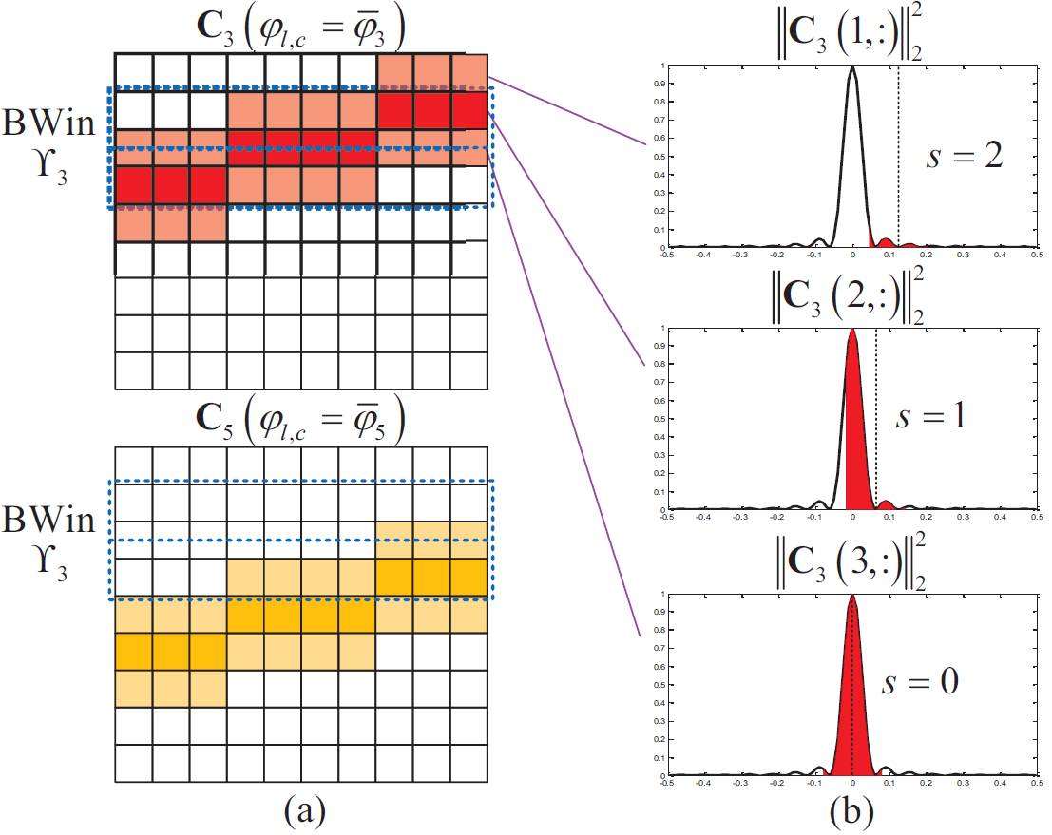
Summary and conclusions
SSD-based scheme
  Each path component enjoys a frequency-dependent sparse structure
  Estimate all path components one-by-one
  Support at different sub-carriers is jointly estimated
Performance
  Achieve higher accuracy in all considered SNR regions.
Notes:
In this paper, we proposed a SSD algorithm to estimate wideband beamspace channel. We first proved that each path component of the wideband beamspace channel enjoys a frequency-dependent sparse structure. Based on this, we then proposed to estimate all path components one by one, and the support of each path component at different subcarrier is jointly estimated to improve the accuracy. Simulation results verified that our scheme achieves higher accuracy than existing schemes in all considered SNR regions.

Slide 23
Thank you !
Contact information
  Xinyu Gao, Tsinghua University
  Email: xy-gao14@mails.tsinghua.edu.cn
Notes:
That’s all. Thanks for your attention.

